Slide 1
BCA Fifth Semester CACS301: MIS and E-Business

Slide 2
Unit 2:The Network Infrastructure for E-Commerce LH 7
Introduction to Information Superhighway (I-Way)
Components of the I-Way
Internet as a network infrastructure.
Wireless Application Protocol:
Wireless Application Protocol (WAP)
Architecture of WAP; Working of WAP
Wireless Technologies:
ADSL
WiMAX
WLAN
WMAN
Wi-Fi
UMTS (3G)
LTE (4G)
(5G NR).
Security Issues related to Wireless Communications.

Slide 3
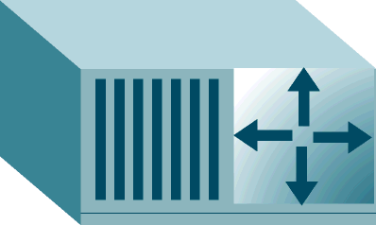
Regional
Network
Modem
Modem
Router
Satellite
link
Internet
Provider
Network
Access
Point
Regional
Network
T3 line
Router
Backbone
Router
Ethernet Network
Network
Access
Point
T1 line
Notes:
Ethernet over Copper Lines Ethernet over Copper (EoC) is a modern technical upgrade to legacy T1. It uses the same copper telephone lines, but can support higher speeds. Bandwidths of 10 or 20 Mbps are common within metro areas. Some support is also available for rural businesses, but not as ubiquitous as T1 service. Additionally, EoC is generally less expensive per Mbps than traditional T1 lines. You can often get twice or more bandwidth for the same monthly lease cost. T3 Lines T3 lines are in the same technology family as T1 lines. The bandwidth is much higher, 45 Mbps vs 1.5 Mbps. T3 refers to the actual lines, which are coaxial, waveguide or microwave relay. These days T3 is delivered as a service on SONET fiber optic lines and referred to as DS3. Like T1, T3 or DS3 service is highly reliable, dedicated and symmetrical.

Slide 4
Introduction to Information Superhighway (I-Way)
I-Way:
Global network of computers that, potentially, will connect most of world's individuals, firms, and organizations. It is envisioned to provide very high speed access to information in all forms (text, graphics, audio, video) via a telephone or wireless connection. The term was first used in 1985 by Al Gore.
The Information Superhighway is very much a physical network, an infrastructure of modern High-capacity, interactive electronic pipeline providing integrated services. I-way links everyone at home or office to everything else.
The Information Superhighway is a physical network, facilitating the broadband, two-way transmission of any type of digital information, within its own virtual space.

Slide 5
Introduction to Information Superhighway (I-Way)
I-Way:
Any e-commerce application will need the I-Way infrastructure in the same manner as any normal business would require the interstate highway network to carry goods from one place to the other.
I-Way is a network of interconnected data highways of several types:
Cable TV wires
Telephone wires
Cellular and satellite
Radio-based wireless

Slide 6
Introduction to Information Superhighway (I-Way)
I-Way:
I-Way is an interactive two-way high-capacity method of transporting information and services. I-Way is applicable in large volume e-commerce applications as it provides traffic-free telecommunication service. I-Way helps organizations, firms and companies in upgrading their network infrastructure. It also helps companies and organizations in recognizing the following:
1. Their infrastructure
2. Ways to change their business
3. Transaction strategies (marketing, advertising, etc.)
4. Ways to sell their products and services
5. Ways to change their relationship with the customer

Slide 7
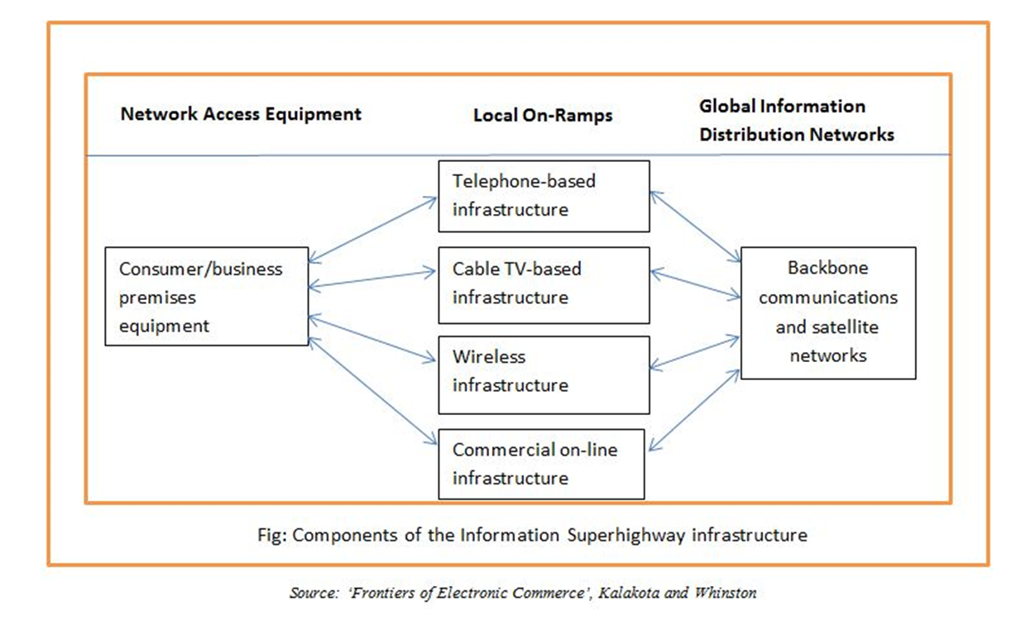
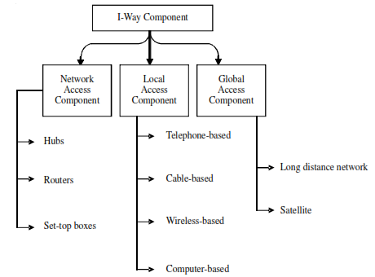
Components of the I-Way
Notes:
Ramp in general term a sloping surface joining two different levels

Slide 8
Network access equipment
To access any network, specific equipment is required at the customer and this enables the consumer to access the network. It consists of hardware, such as routers, switches and access devices, such as computers and set-top boxes. Software platforms are browsers and operating systems.
Local access component
Local access component is the link between businesses, homes, schools and organizations to the main communication point also referred to as the ‘last mile’. Last mile connection represents a tremendous investment that cannot be easily replaced or overlooked in any network strategy. It provides the following types of connections:
(a) Telephone-based channel
(b) Cable-based last channel
(c) Electrical-based last channel
(d) Wireless-based last channel

Slide 9
Global access component
Nowadays, e-commerce activities are not limited to any country; and with the world becoming a global village, a proper network infrastructure is required to connect people and businesses across the world. These types of networks include:
(a) Long distance networks (via coaxial cable or fiber-optic cable)
(b) Satellite

Slide 10
Internet as network infrastructure
Internet:
It is a "network of networks" that includes millions of private and public, academic, business, and government networks (local or Global), linked by copper wires, wireless connections, and other technologies.
Interconnected network of thousands of networks and millions of computers that links businesses, educational institutions, government agencies, and individuals.
Intranet, extranet and cloud computing(SaaS, PaaS, IaaS) are possible with use internet.
World Wide Web (Web)
One of the Internet’s most popular services.
Provides access to billions, possibly trillions, of Web pages.

Slide 11
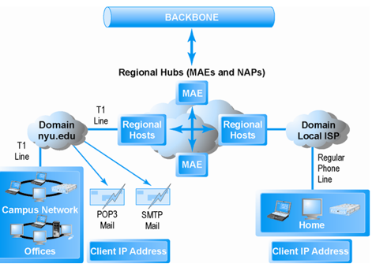
Internet as network infrastructure
Backbone
High-bandwidth fiber optic cable that transports data across the Internet
Network Service Provider (NSP)
Owns and controls one of the major networks comprising the Internet backbone
Bandwidth
Measures how much data can be transferred over a communications medium within a fixed period of time; is usually expressed in bits per second (bps), kilobits per second (Kbps), or megabits per second (Mbps)
Network Access Points and Metropolitan Area Exchanges
One of the hubs where the backbone intersects with regional and local networks, and where the backbone owners connect with one another.
Metropolitan Area Exchanges (MAEs ) another name for one of the hubs where the backbone intersects with regional and local networks.
Notes:
Simple Mail Transfer Protocol (SMTP)
Post Office Protocol version 3 (POP3)

Slide 12
Internet as network infrastructure
Campus Networks
Generally local area networks operating with a single organization that leases access to the Web directly from regional and national carriers
Internet Service Providers
Firm that provides the lowest level of service in the multi-tiered Internet architecture by leasing Internet access to home owners, small businesses, and some large institutions.
Narrowband
The traditional telephone modem connections, now operating at 56.6 Kbps
Broadband
Refers to any communication technology that permits clients to play streaming audio and video files at acceptable speeds -- generally above 100 Kbps Broadband service is based on DSL, cable modem, telephone (T1 and T3 lines), and satellite technologies.
Cable modem
It refers to a cable television technology that digital access to the Internet using the same analog or digital video cable providing television signals to a home. Cable Internet is a major broadband alternative to DSL service, generally providing faster speeds and a “triple play” subscription: telephone, television, and Internet for a single monthly payment.
Digital Subscriber Line (DSL)
It is a telephone technology that provides high-speed access to the Internet through ordinary telephone lines found in a home or business. Service levels range from about 768 Kbps up to 7 Mbps.

Slide 13
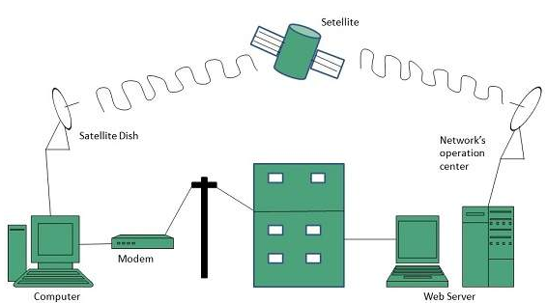
Internet as network infrastructure
T1
An international telephone standard for digital communication that offers guaranteed delivery at 1.54 Mbps
T3
An international telephone standard for digital communication that offers guaranteed delivery at 45Mbps
Satellite
Satellite companies provide high-speed broadband Internet access, primarily to homes and offices located in rural areas where DSL or cable access is not available

Slide 14
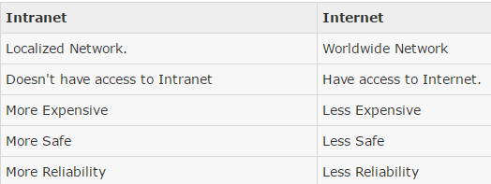
Internet as network infrastructure
Intranet
Intranet is defined as private network of computers within an organization with its own server and firewall. Intranet is system in which multiple PCs are networked to be connected to each other. PCs in intranet are not available to the world outside of the intranet. Usually each company or organization has their own Intranet network and members/employees of that company can access the computers in their intranet.

Slide 15
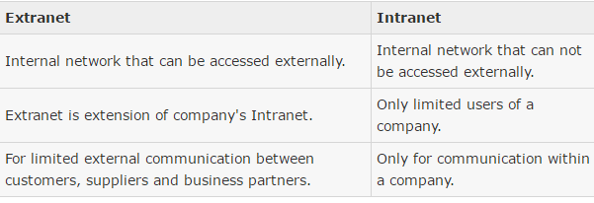
Internet as network infrastructure
Extranet
Extranet refers to network within an organization, using internet to connect to the outsiders in controlled manner. It helps to connect businesses with their customers and suppliers and therefore allows working in a collaborative manner.

Slide 16
Wireless Application Protocol
WAP stands for Wireless Application Protocol.
It is a protocol designed for micro-browsers and it enables the access of internet in the mobile devices.
It uses the mark-up language WML (Wireless Markup Language and not HTML), WML is defined as XML 1.0 application.
It enables creating web applications for mobile devices.
In 1998, WAP Forum was founded by Ericson, Motorola, Nokia and Unwired Planet whose aim was to standardize the various wireless technologies via protocols.
WAP protocol was resulted by the joint efforts of the various members of WAP Forum.

Slide 17
Wireless Application Protocol
WAP achieved some popularity in the early 2000s.
From the 2010s it had been largely superseded by more modern standards.
Most modern handset internet browsers now fully support HTML, so they do not need to use WAP markup for web page compatibility, and therefore, most are no longer able to render and display pages written in WML, WAP's markup language.
Most modern handset internet browsers now support full HTML, CSS, and most of JavaScript, and do not need to use any kind of WAP markup for webpage compatibility.
The list of handsets supporting HTML is extensive, and includes all Android handsets, all versions of the iPhone handset, all Blackberry devices, all devices running Windows Phone, and many Nokia handsets.

Slide 18
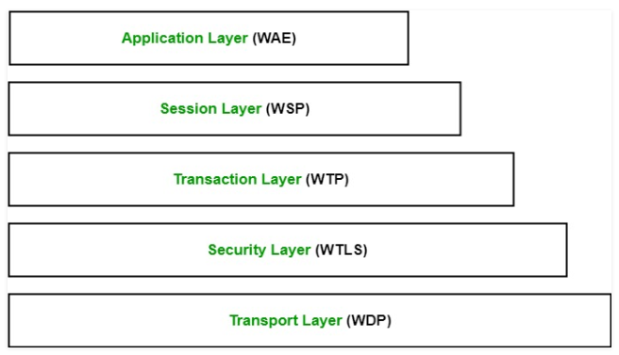
Architecture of WAP

Slide 19
Architecture of WAP
Application Layer: This layer contains the Wireless Application Environment (WAE). It contains mobile device specifications and content development programming languages like WML.
Session Layer: This layer contains Wireless Session Protocol (WSP). It provides fast connection suspension and reconnection.
Transaction Layer: This layer contains Wireless Transaction Protocol (WTP). It runs on top of UDP (User Datagram Protocol) and is a part of TCP/IP and offers transaction support.
Security Layer: This layer contains Wireless Transaction Layer Security (WTLS). It offers data integrity, privacy and authentication.
Transport Layer: This layer contains Wireless Datagram Protocol. It presents consistent data format to higher layers of WAP protocol stack.

Slide 20
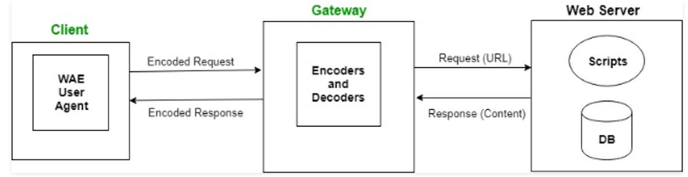
Working mechanism of WAP
The user opens the mini-browser in a mobile device. He selects a website that he wants to view.
The mobile device sends the URL encoded request via network to a WAP gateway using WAP protocol.
The WAP gateway translates this WAP request into a conventional HTTP URL request and sends it over the internet.
The request reaches to a specified Web server and it processes the request just as it would have processed any other request and sends the response back to the mobile device through WAP gateway in WML file which can be seen in the micro-browser.

Slide 21
Wireless Technologies
Wireless technology refers to technology that allows us to communicate without using cables or wires. Wireless technology provides the ability to communicate between two or more entities over distances without the use of wires or cables of any sort. This includes communications using electromagnetic waves through the air.

Slide 22
Some of the characteristics of wireless communications systems which make it attractive for users are:
1. Mobility − A wireless communications system allows users to access information beyond their
desk and conduct business from anywhere without having a wire connectivity.
2. Reachability − Wireless communication systems enable people to be stay connected and be reachable, regardless of the location they are operating from.
3. Simplicity − Wireless communication system are easy and fast to deploy in comparison of cabled network. Initial setup cost could be a bit high but other advantages overcome that high cost.
4. Maintainability − In a wireless system, you do not have to spend too much cost and time to maintain the network setup.
5. Roaming Services − Using a wireless network system, you can provide service anywhere any time including train, buses, airplanes etc.
6. New Services − Wireless communication systems provide various smart services like SMS and
MMS.

Slide 23
Different technologies used for data communication are:
• ADSL
• WiMAX
• WLAN
• WMAN
• Wi-Fi Wireless Technologies
• UMTS (3G)
• LTE (4G)
• NR (5G)
Notes:
Universal Mobile Telecommunications Service (UMTS) refers to a group of radio technologies associated with the third generation of cellular networks (3G).
LTE (Long-Term Evolution) is a fourth-generation (4G) wireless standard that provides increased network capacity and speed for cellphones and other cellular devices compared with third-generation (3G) technology
5G NR (New Radio) is a radio access technology (RAT) developed by the 3rd Generation Partnership Project (3GPP) for the 5G (fifth generation) mobile network.^{[1]} It was designed to be the global standard for the air interface of 5G networks.^{[2]} It is based on orthogonal frequency-division multiplexing (OFDM), as is the 4G (fourth generation) long-term evolution (LTE) standard.

Slide 24
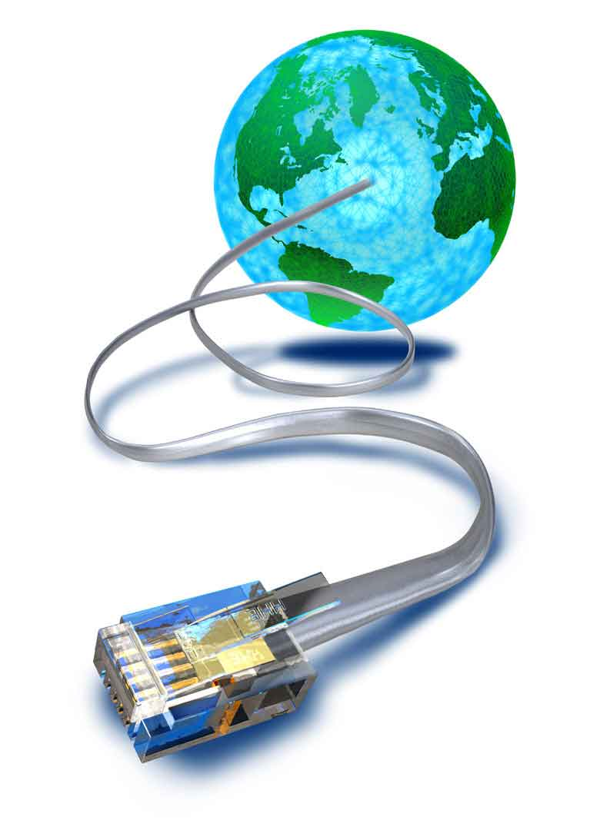
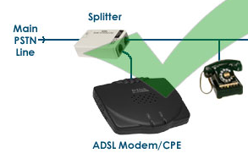
Wireless Technologies
ADSL (Asymmetric Digital Subscriber Line)
ADSL is a high-speed Internet access service that utilizes existing copper telephones lines to send and receive data at speeds that far exceed conventional dial-up modems.
ADSL uses standard telephone lines to transmit upstream and downstream data on a digital frequency, which sets these data streams apart from the analog signals telephones and fax machines use.
ADSL allows data stream speeds from 1.5 to 8 megabits per second (Mbps).
The "asymmetric" in ADSL refers to the fact that the downstream data rate, or the data coming to your computer from the Internet, is traveling faster than upstream data, or the data traveling from your computer to the Internet.

Slide 25
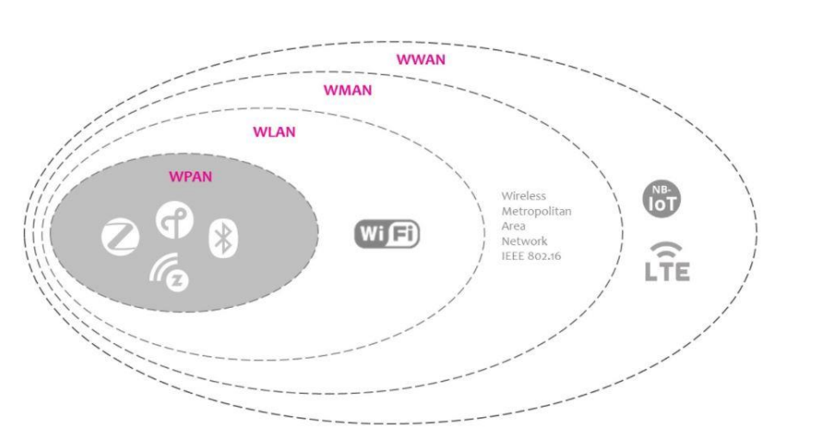
WPAN, WLAN, WMAN and WWAN

Slide 26
WPAN
It connect devices within a small area, somewhere around within a person's reach. It has a typical range of about 30 feet.
It commonly used to interconnect compatible devices near a central location, such as a desk.
With billions of wireless devices on the air already, and many billions more projected to join them in the next few years, many radio frequency bands are becoming crowded, and interference is a growing problem.
Wireless Network Technologies carrying over WPAN: Bluetooth radio, Bluetooth Low Energy, ZigBee, ZWave, Thread, infrared.

Slide 27
WLANs
WLANs allows users to linking of two or more devices using a wireless distribution method that providing a connection through access points to the wider Internet. It provides mobility function to its users to covers local area such as a university campus, library or canteen, small offices or home to maintaining a network or gain access to the internet.
In this technology a temporary network can be formed by a small number of users without the need of an access point (APs); given that they do not need access to network resources. Sometimes it calls a local area wireless network (LAWN).
WLAN are wireless networks that use radio waves. The backbone network usually uses cables, with one or more wireless access points connecting the wireless users to the wired network. The range of a Wireless Local Area Network can be anywhere from a single room to an entire campus. Wi-Fi is the common technology used in WLAN.

Slide 28
WWAN
:
Wireless Wide Area Network types of networks can be maintained over large areas, such as neighboring
towns, cities or countries, via multiple satellite systems or antenna sites looked after by an ISP.
These types of systems are referred to as 2G (2nd Generation), 3G (3rd Generation), 4G (4th Generation)
systems and upcoming generation.
WWAN services are typically delivered to smart phones and other handheld devices sold by cellular service
providers. In the family of WWAN technologies includes GSM/UMTS, CDMA etc
Notes:
GSM is a second-generation (2G)
Universal Mobile Telecommunications Service (UMTS) refers to a group of radio technologies associated with the third generation of cellular networks (3G).
Code-division multiple access (CDMA) is a channel access method used by various radio communication technologies. CDMA is an example of multiple access, where several transmitters can send information simultaneously over a single communication channel.

Slide 29
ADSL
Advantages: Affordable, Large coverage area, does not affect your landline phone calls
Disadvantages: Low speed, Distance-sensitive, Susceptible to electrical noise
Notes:
Miniscule-Tiny or small

Slide 30
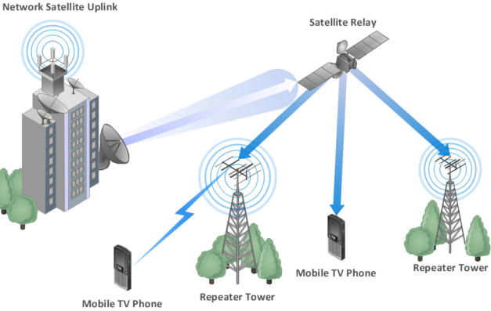
Wireless Area Network
Wireless WAN is a wide area network in which separate areas of coverage or cells are connected wirelessly to provide service to a large geographic area
This network enables you to access the Internet via a wireless wide area network (WWAN) access card and a PDA or laptop.
These networks provide a very fast data speed compared with the data rates of mobile telecommunications technology, and their range is also extensive. Cellular and mobile networks based on CDMA(Code division multiple access) and GSM(Global System for Mobile Communications), satellite are good examples of WWAN.
Notes:
Global System for Mobile Communications
Code division multiple access

Slide 31
What is WiMAX?
WiMAX stands for Worldwide Interoperability for Microwave Access
• WiMAX stands for Worldwide Interoperability for Microwave Access.
• It is an IP based Wireless Broadband Access Technology.
• It is an alternative to wired broadband, such as DSL and cable modem.
• It is a broadband wireless networks that are based on the IEEE 802.16 standard, which ensures
compatibility and interoperability between broadband wireless access equipment.
• It operates similar to Wi-Fi, but at higher speeds over greater distances and for a greater
number of users. It has the ability to provide service even in areas that are difficult for wired
infrastructure to reach.
• It is expected to offer up to about 40Mbps capacity per wireless channel for both fixed and
portable applications, depending on the particular technical configuration chosen enough to
support hundreds of businesses with T-1 speed connectivity and thousands of residences with
DSL speed connectivity.
• It can support voice and video as well as Internet data

Slide 32
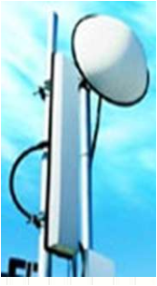
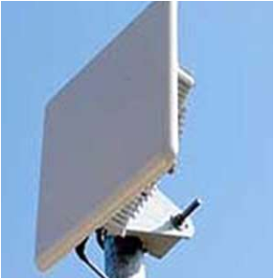
Fundamental WiMAX Concepts
Base Station (BS) The BS is the node that logically connects wireless subscriber devices to operator networks. The BS maintains communications with subscriber devices and governs access to the operator networks.
A WiMAX tower, similar in concept to a cell-phone tower – A single WiMAX tower can provide coverage to a very large area.
Subscriber Station (SS). The SS is a stationary WiMAX-capable radio system that communicates with a base station, although it may also connect to a relay station in multi-hop relay network operations.

Slide 33
BENEFITS OF WIMAX
Benefits of using WiMAX
1. It can support high bandwidth solutions that is required for a full range of high-value multimedia services.
2. It can help service providers meet many of the challenges they face due to increasing customer demands without discarding their existing infrastructure investments as it can seamlessly interoperate across various network types.
3. It can provide wide area coverage and quality of service capabilities for applications ranging from VoIP to real-time streaming video and non-real time downloads, ensuring the subscribers obtain the performance they expect for all types of communications.
4. It can integrate with third generation (3G) mobile, wireless and wired networks allowing it to become part of a seamless anytime, anywhere broadband access solution.

Slide 34
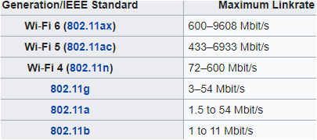
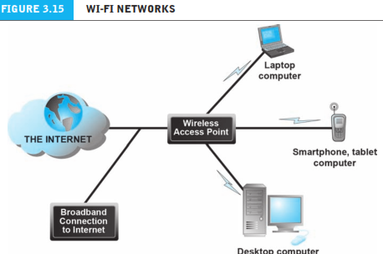
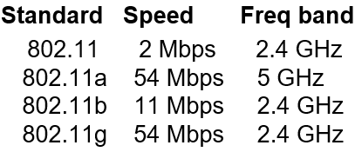
What is Wi-Fi?
Wi-fi is stands for Wireless Fidelity
Wi-fi is a wireless technology that uses radio frequency to transmit data through the air.
WiFi is a universal wireless networking technology that utilizes radio frequencies to transfer data.
Vic-Hayes has been called the "father of Wi-Fi".
Wi-Fi allows you to use your computer or other device to connect to the internet from anywhere there is a Wi-Fi access point (often known as a hot Spot)
WiFi is the wireless way to handle networking.
It is also known as 802.11 networking.
The big advantage of WiFi is its simplicity.
we can connect computers anywhere in our home or office without the need for wires. The computers connect to the network using radio signals, and computers can be up to 100 feet or so apart.

Slide 35
wifi
Working concept:
Radio signals: These are the key, which make Wi-Fi networking possible. The radio signals transmitted
from Wi-Fi antennas are picked up by Wi-Fi receivers, such as computers and cell phones that are
equipped with Wi-Fi cards.
Wi-Fi cards: We can think of Wi-Fi cards as being invisible cords that connect the computer to the antenna
for a direct connection to the internet.
Wi-Fi cards can be external or internal. If a Wi-Fi card is not installed in your computer, then we may
attach a USB antenna externally or have an antenna-equipped expansion card installed directly to the
computer

Slide 36
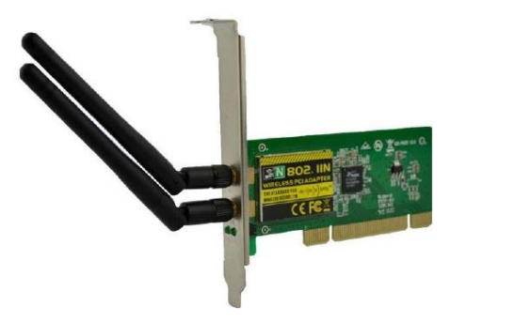

Slide 37
Wi-Fi Hotspots: A Wi-Fi hotspot is created by installing an access point to an internet connection. The access point transmits a wireless signal over a short distance. It typically covers around 300 feet. When a Wi-Fi enabled device such as a smartphone encounters a hotspot, the device can then connect to that network wirelessly

Slide 38
Major Issues in Wi-Fi
There are a few issues in Wi-Fi −
1. Security Problems
2. Compatibility and Interoperability − One of the major problems with Wi-Fi is its compatibility and
interoperability. For example, 802.11a products are not compatible with 802.11b products. Due
to different operating frequencies, 802.11a hotspots would not help an 802.11b client. Due to
lack of standardization, harmonization, and certification, different vendors come out with
products that do not work with each other.
3. Billing Issues – Wi-Fi vendors are also looking for ways to solve the problem of back-end
integration and billing, which have dogged the roll-out of commercial Wi-Fi hotspots. Some of the
ideas under consideration for Wi-Fi billing such as per day, per hour, and unlimited monthly
connection fees.

Slide 39
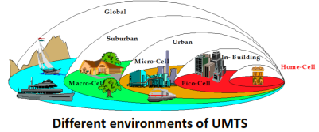
3G(UMTS)
3G actually stands for “third generation”, as it is the third type of access technology that has been made widely commercially available for connecting mobile phones.
It is also known as UMTS which stands for Universal Mobile Telecommunication System.
It is one of the THIRD GENERATION (3G) mobile phone technology
It is standardized by 3GPP (Third Generation Partnership Project)
First step towards all-IP vision
It is an evolution of GSM technology(Global System for Mobile)
UMTS, the 3G successor to GSM, utilizes the W-CDMA(Wideband Code-Division Multiple Access) air interface and GSM infrastructures, so it is also called 3GSM
UMTS is an upgrade from GSM via GPRS ( General Packet Radio Service)
Data rates of UMTS are:
144 kbps for rural
384 kbps for urban outdoor
2048 kbps for indoor and low range outdoor

Slide 40
Advantages and Disadvantage
Fast Internet
Smooth Multimedia Messaging (MMS)
Enhanced Location based services
Enhanced Communication (Email, IM, File sharing)
Increased Capacity compared to 2G
Disadvantage
Poor Video Experience
Drains battery
Expensive that GSM
Still not full Broadband

Slide 41
4G (LTE)
4G means the fourth generation of data technology for cellular networks̶ following 3G, the third generation. LTE stands for Long Term Evolution and is short for a very technical process for high-speed data for phones and other mobile devices. Together, they make 4G LTE ̶ the fastest 4G service available today.
It is designed to provide up to 10x the speeds of 3G networks for mobile devices such as smartphones, tablets, netbooks, notebooks and wireless hotspots.
4G technologies are designed to provide IP-based voice, data and multimedia streaming at speeds of at least 100 Mbit per second and up to as fast as 1 GBit per second.
With the power of 4G LTE, you can share and stream video in high definition; game in near-real time; surf quickly and easily; and download songs and photos in seconds and movies in minutes.

Slide 42
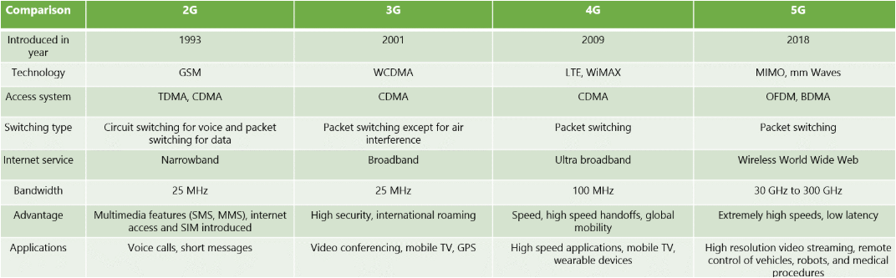
2G vs 3G vs 4G vs 5G

Slide 43
Security Issues related to Wireless Communications
1. DENIAL OF SERVICE
Denial of service is a simple attack that relies on limiting access to services on a wired or wireless network.
This hack is commonly accomplished by routing a tremendous amount of traffic at a specified target.
With this approach, the high volume of traffic overwhelms the target machine and disrupts service.
It is also possible for hackers to launch a denial of service attack by simply disrupting the signal on the network.
This can be achieved by causing enough interference on one channel to interrupt the service.

Slide 44
Security Issues related to Wireless Communications
2. ROGUE ACCESS
A common method of attack used by hackers is the use of a rogue access point that is setup within range of your existing wireless network.
The concept behind a rogue access point is simple. Hackers establish these false networks to fool people and devices in range to use those access points.
This allows hackers to access data and information on legitimate devices that should be secure.

Slide 45
Security Issues related to Wireless Communications
3. PASSIVE CAPTURING
Passive capturing is another threat to security on your wireless network.
Passive capturing is accomplished by setting up devices within range of the network and "listening" to the data traffic traveling along your network and capturing that information.
What hackers do with that information differs depending upon the goal of the hacker.
Some attempt to breakthrough your existing security settings by analyzing network traffic, while others simply look through the non-secured traffic to potentially access sensitive information regarding business operations.

